Slide 1

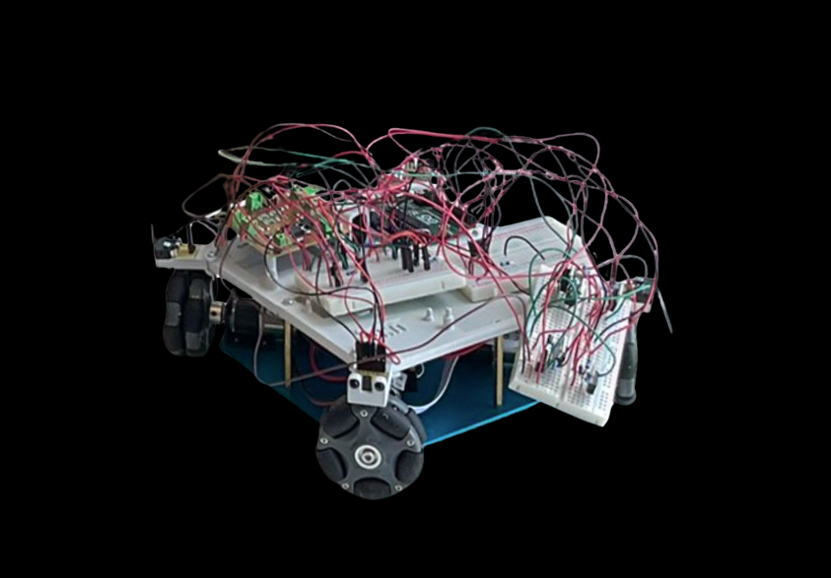
OPEN DAY ROBOTS
YOUR OPPORTUNITY TO LEARN ROBOTICS IN 90 MINS

Slide 2
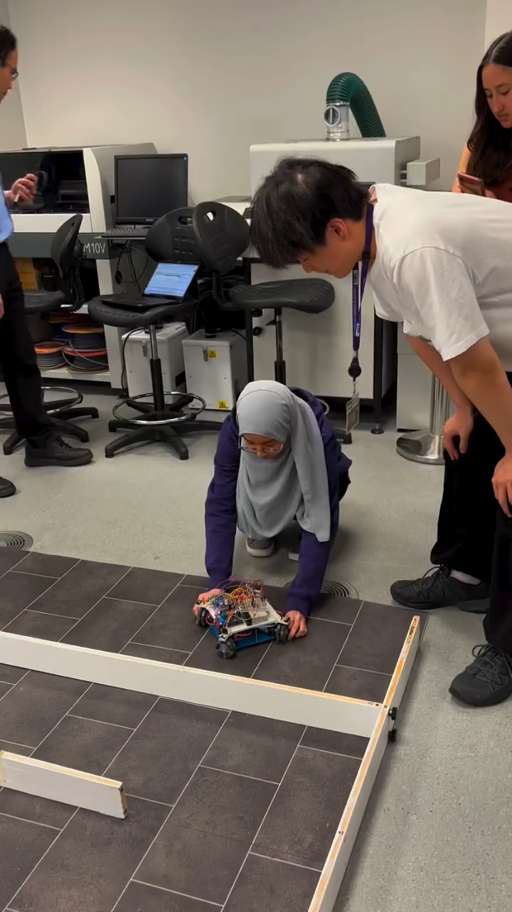

Slide 3
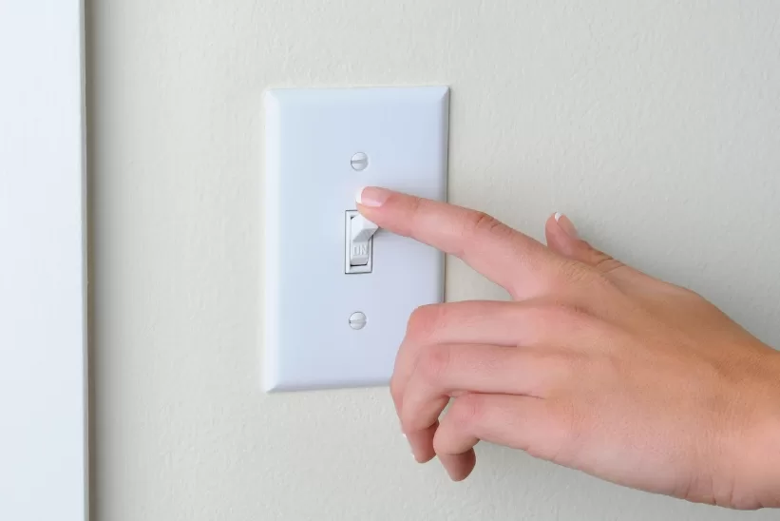

Slide 4
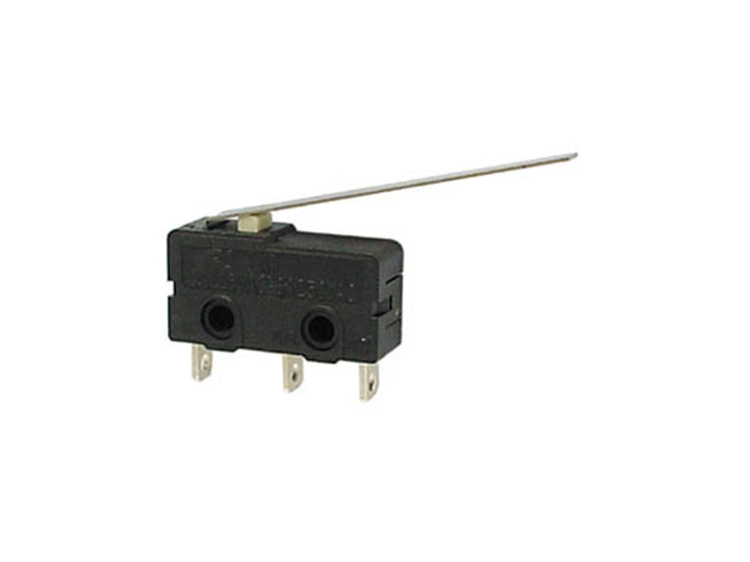

Slide 5
=

Slide 6



Slide 7
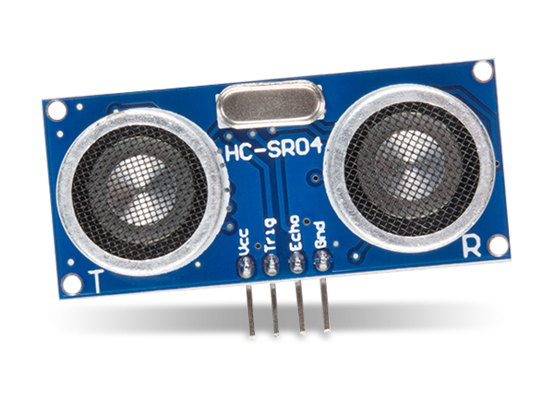


Slide 8
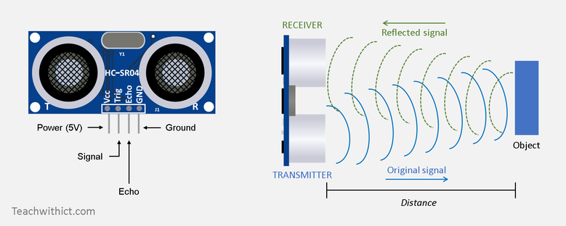

Slide 9
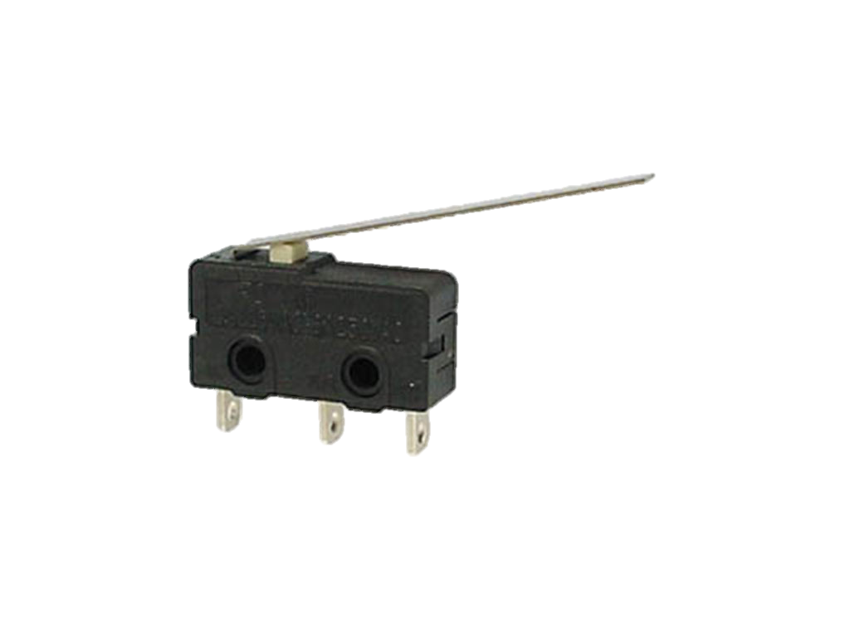

Slide 10
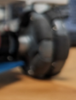

Slide 11
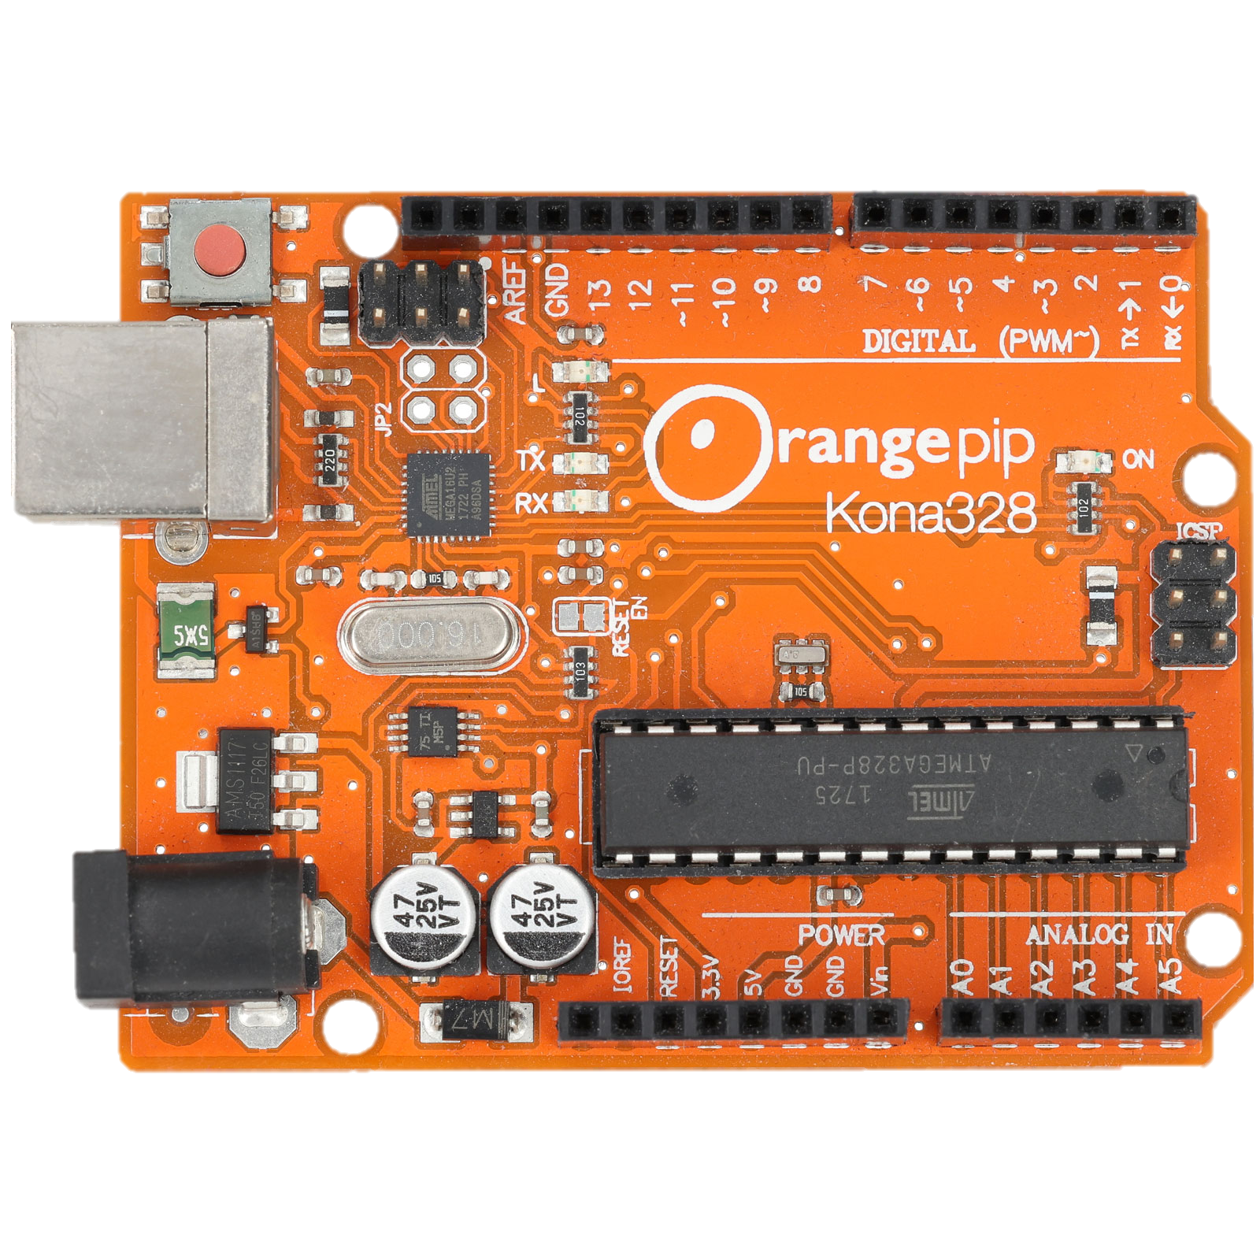

Slide 12
Microcontroller
Used to control electronics

Slide 14
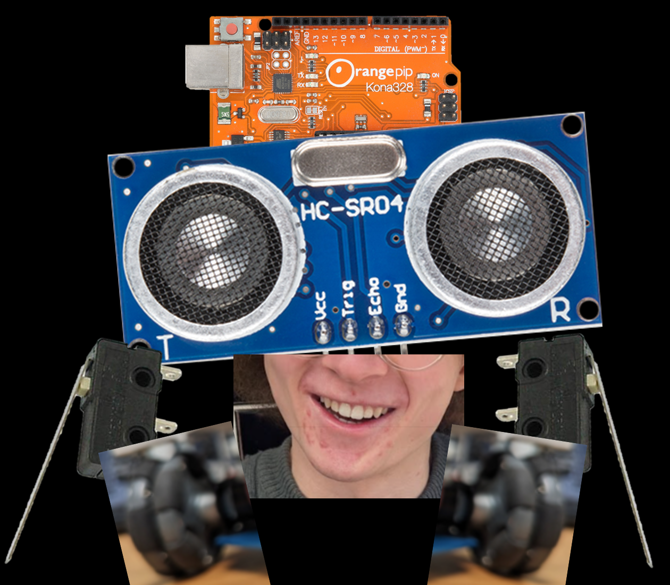
BRAIN = empty

Slide 15
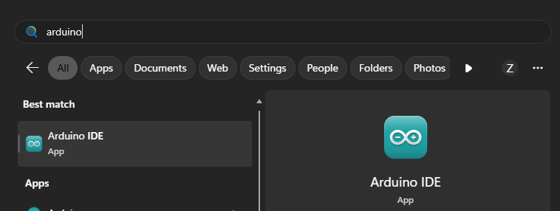

Slide 16
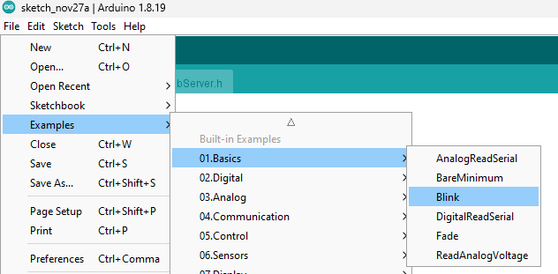


Slide 17
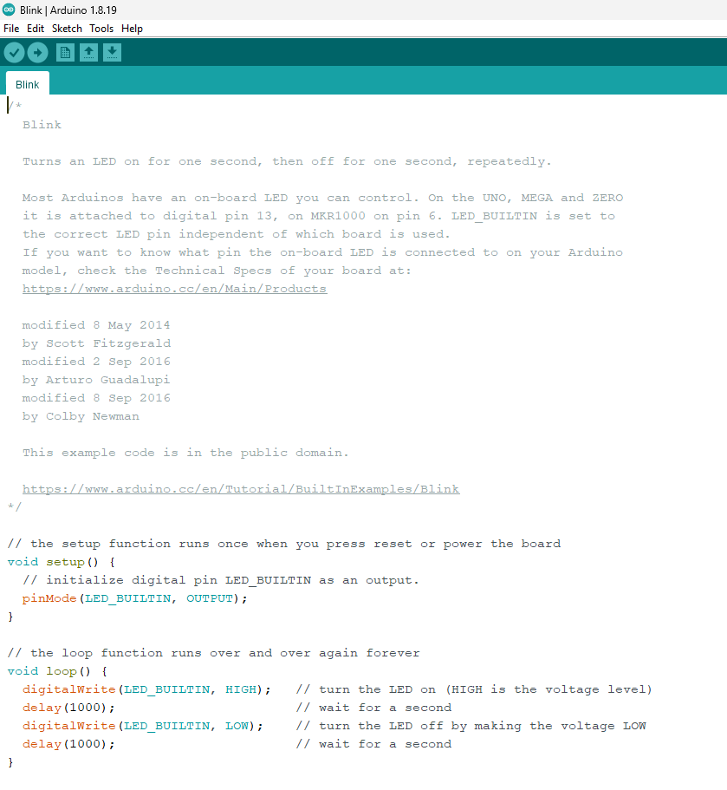

Slide 18

Plug in your Arduino <3

Slide 19
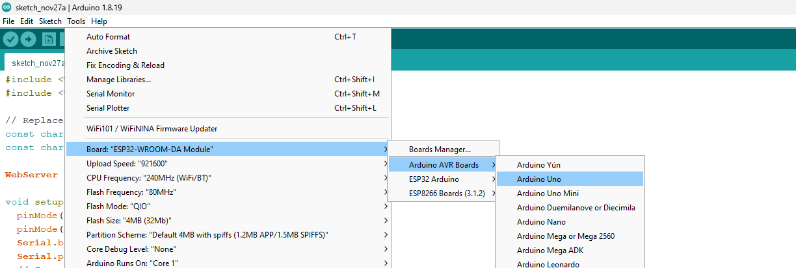





Slide 20
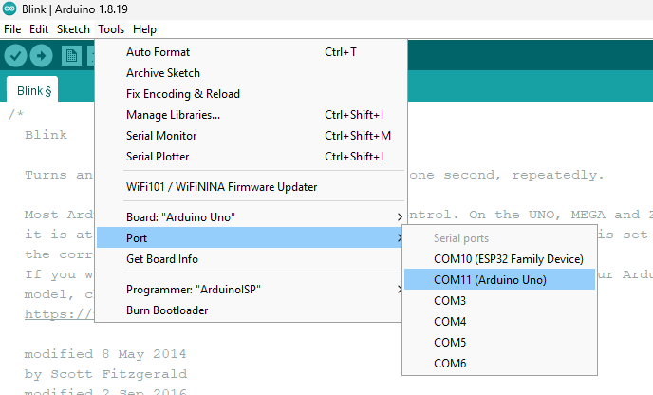



Slide 21
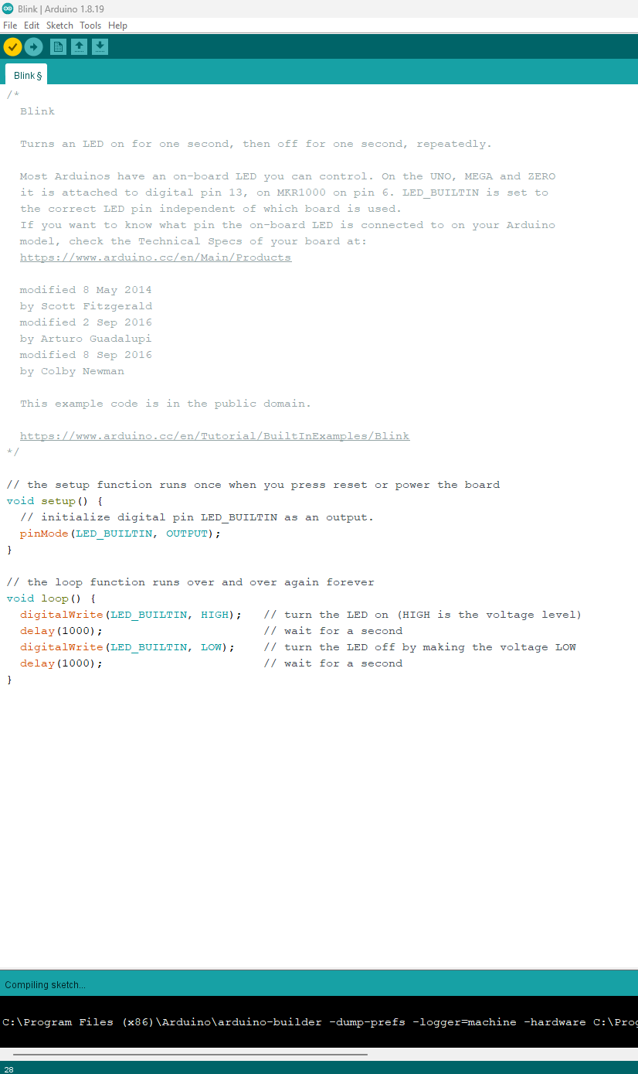
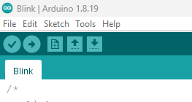







Slide 22
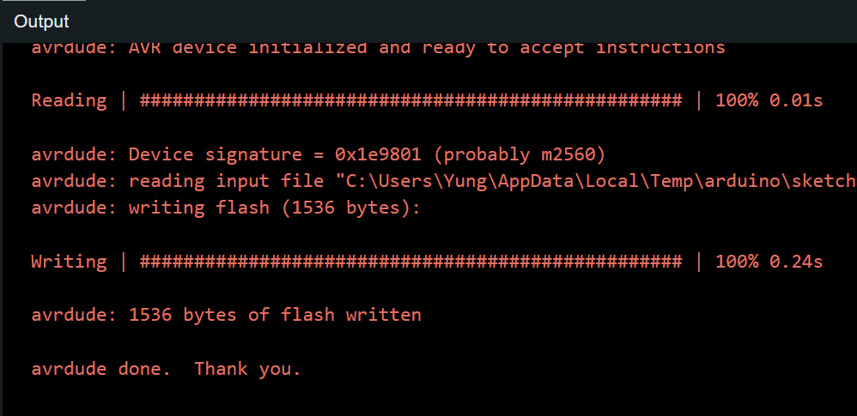


Slide 23










Slide 24
Demonstrate how to plug in battery!
Make sure the switch on the board is OFF
Double check the polarity.

Slide 25
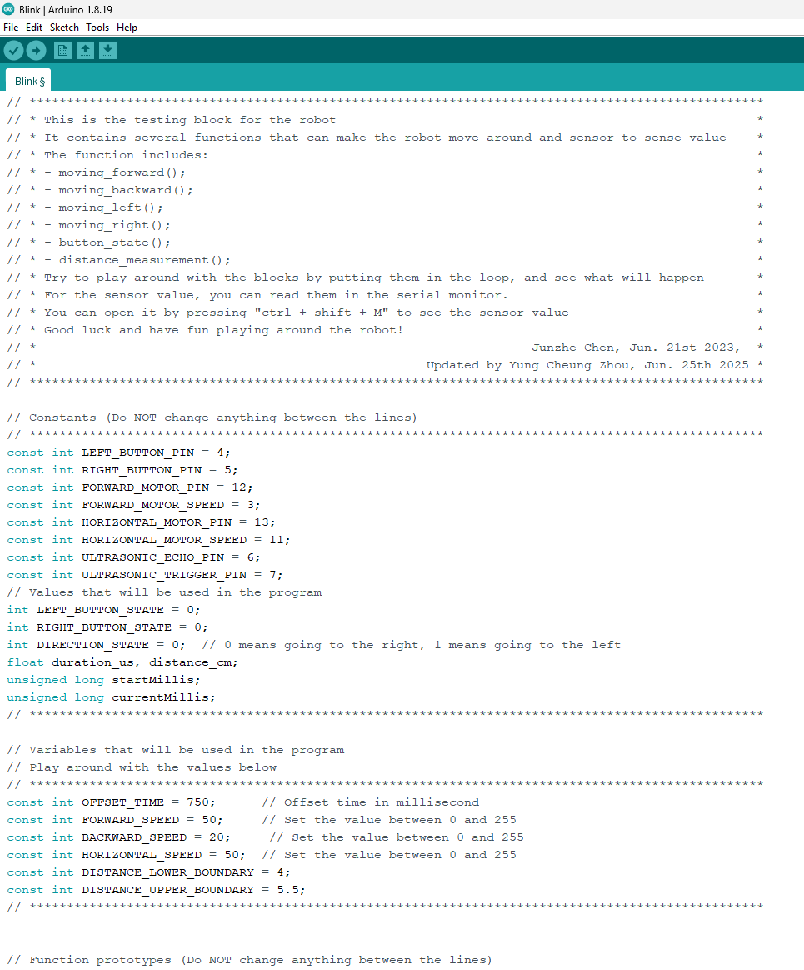
https://raw.flemingsociety.com/robot.txt
COPY ALL code (CTRL + A > CTRL + C)
Replace all code on Arduino (CTRL + A > CTRL + V)

Slide 26
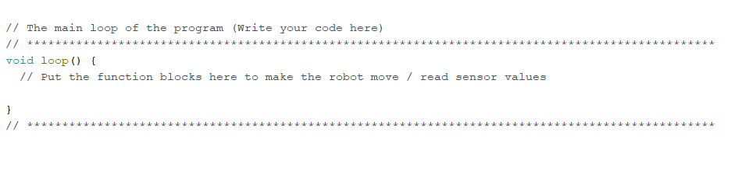
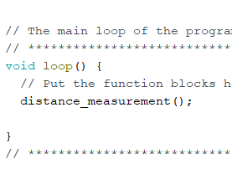
Find this
Type this: distance_measurement();

Slide 27






Slide 28
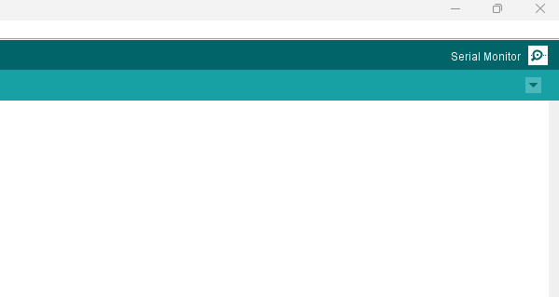



Slide 29
Now try : moving_forward();
moving_backward();
moving_left();
moving_right();
button_state();
distance_measurement();

Slide 30
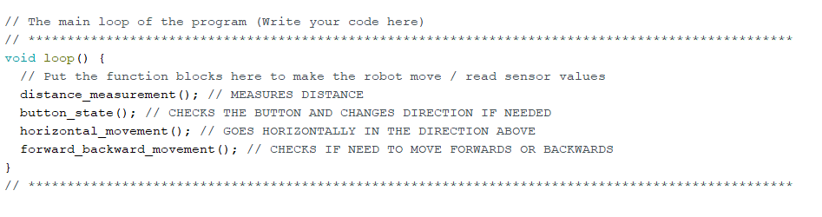
FINAL CODE

Slide 31
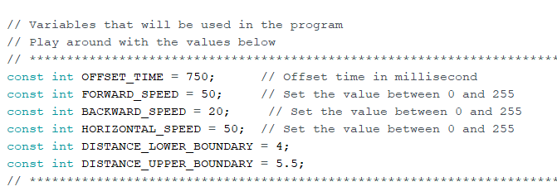
CHALLENGES
MOVE DIAGONALLY TO SOLVE THE MAZE FASTER
PRE-EMPTIVE DIRECTION DECISION MAKING
(change directions after going through a gap)
LEADERBOARD
STUCK ON A CORNER?
YOU’RE THE ENGINEER!
CHANGE THESE!
WINNER WINS A PRICE
Broke your robot? Full code: https://raw.flemingsociety.com/workingrobot.txt

